Slide 2
ENDTERM SYNOPSIS PRESENTATION December 2020
Data Analysis Using Formal Concept Analysis
Minor Project-1
Sem-V (Batch 2018-2022)
UNDER THE GUIDANCE OF
Mr. Bikram Pratim Bhuyan
Assistant Professor, Department of Informatics, SOCS, UPES Dehradun
Group Details:
SAP ID ROLL NO. BRANCH Avik Singla 500067990 R103218190 CSE-BAO
Sourabh Bhandari 500071057 R103218207 CSE-BAO
Vaishnavi Jaiswal 500071059 R103218199 CSE-BAO Vivek Raj 500069212 R103218189 CSE-BAO
Mentor Email: bpbhuyan@ddn.upes.ac.in

Slide 3
ABSTRACT
Now a days, data analysis has been playing a major role in various fields and required in many domains.
This work covers a detailed description of Formal Concept Analysis which covers how different processes in data analysis can be performed with the help of concepts.
The work begins by finding the concepts from the context followed by performing tasks like association rule mining, stability and clustering.
Keywords : Data Analysis, Formal Concept Analysis, Association Rule Mining, Clustering, Stability, Concepts.

Slide 4
PROBLEM STATEMENT Here we aim at analyzing a dataset from stock market Nifty 50(Top 50 companies of India listed on NSE). We will apply the concepts and algorithms used in formal concept analysis and list out the filtered concepts according to the attributes provided. As a result, we will get concepts that will enable us to list companies according to their previous performance and other metrics.

Slide 5
OBJECTIVE
Study about Formal Concept Analysis: - Understanding the basic terminologies used in formal concept analysis.
Concept generation from given context: - Implementing algorithm to generate all concepts from the given context.
Prioritizing concepts: - Finding dependencies between the objects and attributes using stability index.
Clustering :- Arranging objects into groups according to their similar attributes.
Storing and Searching of Concepts using Linked Lists.

Slide 6
PROJECT INTRODUCTION
Formal concept analysis is a method of data analysis which deals with object-attribute input data and aims at extracting from the data clusters also called formal concepts.
It acquires groupings, called formal concepts, from Boolean data named context, comprising of objects and attributes.
The root of FCA is a formal context from which concepts are generated and are organized in a hierarchical order.

Slide 7
LITERATURE SURVEY
Formal Concept Analysis is a method which was devised in the early 1980s by R. Wille. He used the philosophical interpretation of the concept as a unit of thought comprising of a set of objects and a set of their shared attributes.
During the last three decades, it became a popular human-centered tool for knowledge representation and data analysis with numerous applications. It covered FCA topics including Information Retrieval with a focus on visualization aspects, Machine Learning, Data Mining and Knowledge Discovery, Text Mining and several others.

Slide 8
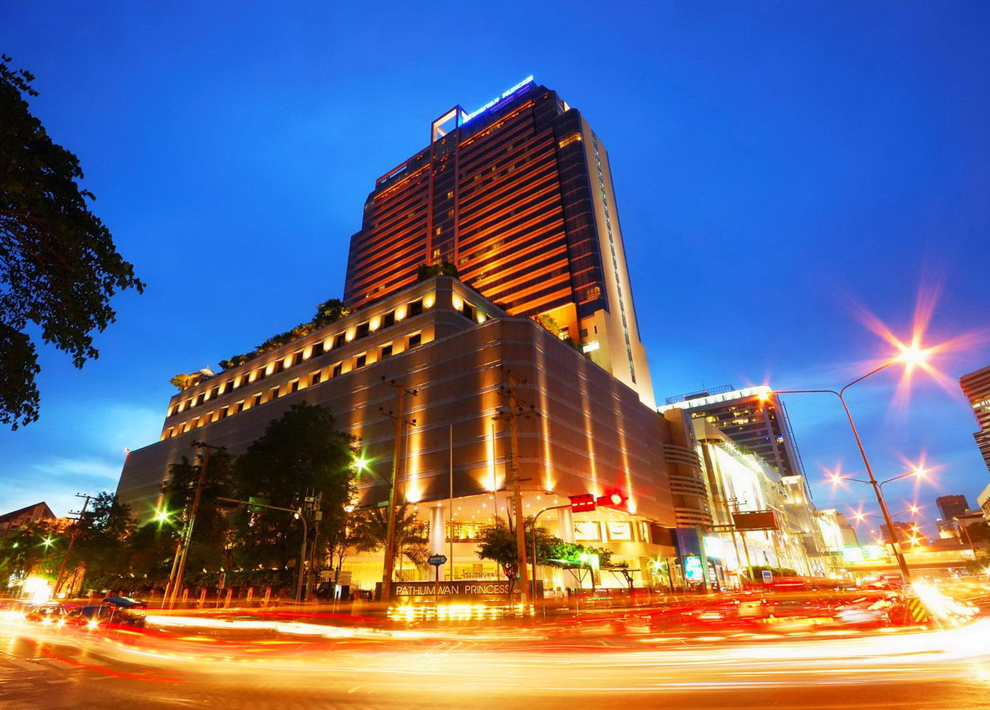
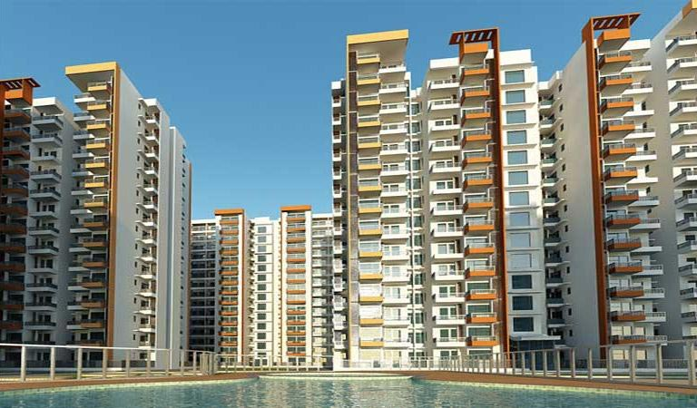
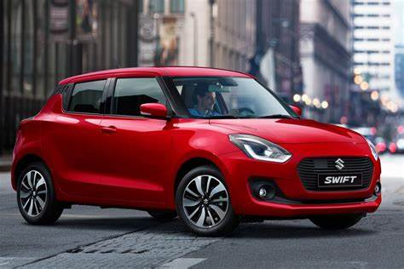
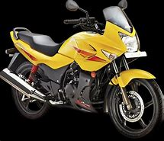


Formal Context
Formal context: A matrix called formal context defines which objects have a given
property and vice versa which properties a given object has.
Attributes (Intent)
Objects (Extent)
This table represents tourism domain knowledge
as formal concept.
Here ‘X’ means that an object has that attribute.

Slide 9
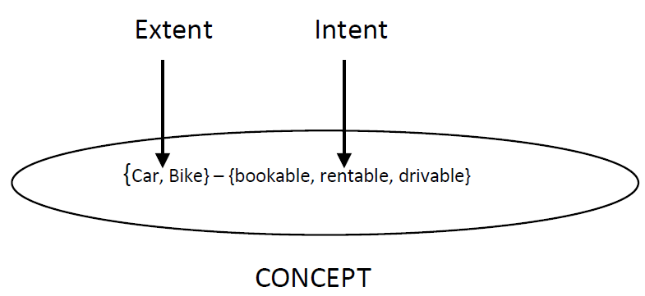
Formal Concepts
Formal concept: A pair of objects and properties such that the objects share exactly the properties and the properties apply to exactly the objects is called formal concept.
Example: {Car,Bike} – {bookable, rentable, driveable} is a formal concept where objects {Car,Bike} has common attributes {bookable, rentable, driveable}.
Extent: Set of objects covered by the concept. Example: {Car,Bike}
Intent: Set of attributes covered by the concept. Example: {bookable, rentable, driveable}
Example: Concept 1 : < {Car, Bike} , {Bookable, Rentable, Drivable} >
Concept 2: < { Excursion, Trip}, {Joinable} >
Concept 3: < { ∅ } , {Bookable , Rentable, Driveable, Rideable, Joinable } >

Slide 10
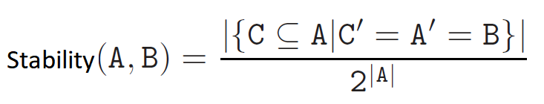
Stability
In Formal Concept Analysis, stability is an important utility measure in prioritizing concepts.
Say we have a concept with attribute set A and object set B.
We are going to calculate stability which tells us How strongly concept extents depends on particular attributes of concept intents. Stability is calculated as the Ratio between number of subsets(C) of A that generate B by total number of subsets of A.
Here, ′ represents derivative of particular extent or intent.
and |A| represents cardinality of set A.

Slide 11
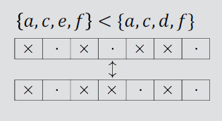
ALGORITHMS ALGORITHM 1: All closures ( M , ’’ ) : generating all closed sets Input: A closure operator X->X’’ on a finite linearly ordered set M. Output: All closed sets in lectic order. A = FirstClosure( ” ) while A =! NULL do Output A A := NextClosure ( A , M , ’’ ) ALGORITHM 2: First Closure ( ’’ ) Input: A closure operator X->X” on a finite linearly ordered set. Output: The lectically first closed set, i.e., the closure of the empty set. return 0
Lectic Order

Slide 12
ALGORITHM 3: Next Closure ( A , M , ” ) Input: A closure operator X->X” on a finite linearly ordered set M and a subset A ∈ M. Output: The lectically next closed set after A if it exists; NULL otherwise. For all m ∈ M in reverse order do if M ∈ A then A := A – {m} else B := (A U {m})’’ If B-A contains no element < m then Return B return NULL

Slide 13
ALGORITHM 4: Stability Finding Stability index for filtering. Input :- Set of attribute A, set of object B and Context Output :- Stability index for given concept num=0,dem=2^M For all C, where C is all possible subsets of M: if derivative of C =B num++ return num/dem

Slide 14
Stock Market Analysis
We have arranged a dataset for nifty 50 companies with some of the attributes like EPS, P/E Ratio, D/E Ratio etc.
And will finally provide relationships between the companies and attributes which will further help us to understand these relationship and how strongly these are connected to each other.
Here a threshold value will be given by the user which will provide them with combinations of concepts and help them in searching whether the concept of some companies is present or not and find a suitable according to his/her investment needs.

Slide 15
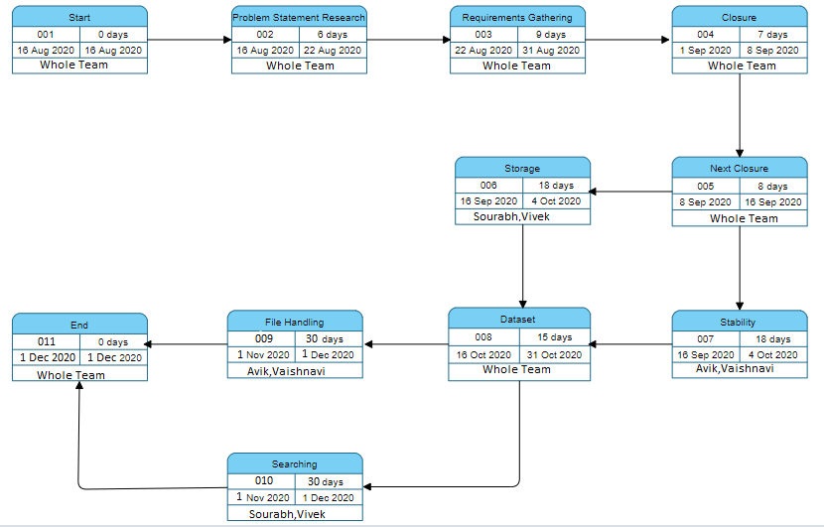
PERT CHART
STATUS OF PROJECT PROGRESS: ACTIVE/WORKING

Slide 16
REFERENCES
[1] https://www.coursera.org/learn/formal-concept-analysis , Sergei Obiedkov,
National Research University Higher School of Economics.
[2] https://www.upriss.org.uk/ Uta Priss, 2006.
[3] Algorithms used:
Next Closure, Stability from
Dmitry I. Ignatov: Introduction to Formal Concept Analysis and Its Applications in Information Retrieval and Related Fields, National Research University Higher School of Economics, Moscow, 2015. https://bit.ly/2JpnYWf
[4] https://en.wikipedia.org/wiki/Formal_concept_analysis
[5] Financial Information for building dataset:
https://moneycontrol.com
https://finviz.com
https://screener.in

